Slide 1
Monty MATLAB Group 5
Alexander Schölles, Rayene Messaoud, Tobias Hofmann, Tobias Krug

Slide 2
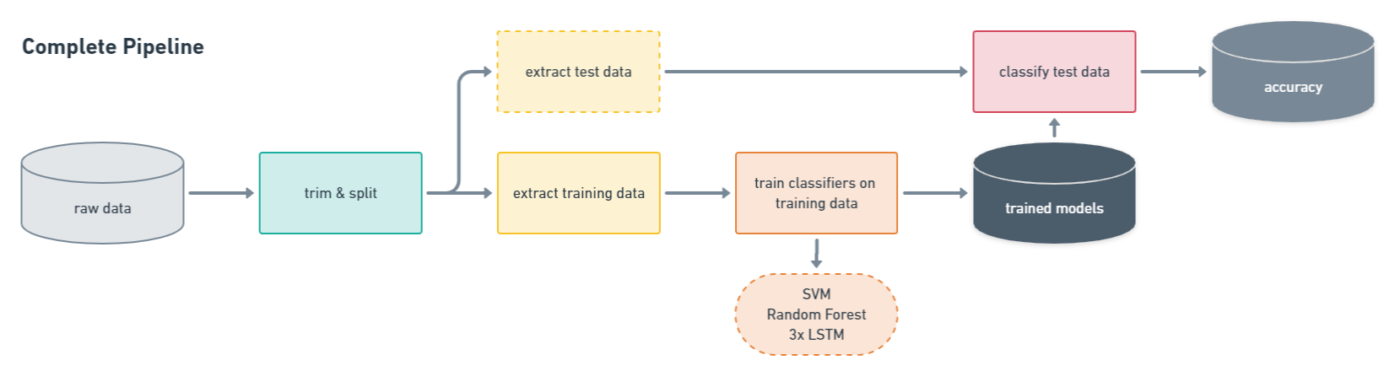
Notes:
Explain whole algorithm pipeline.

Slide 3
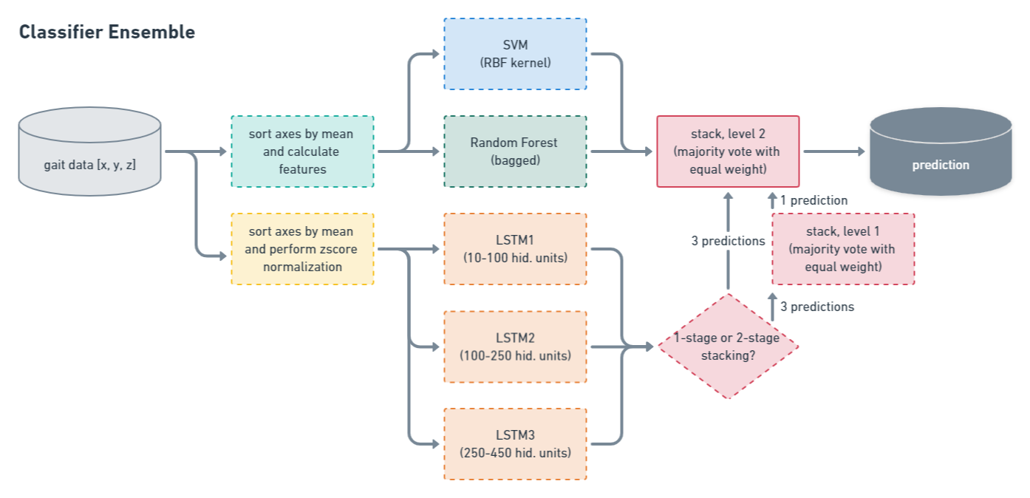
Notes:
Explain model selection, training and classification.

Slide 4
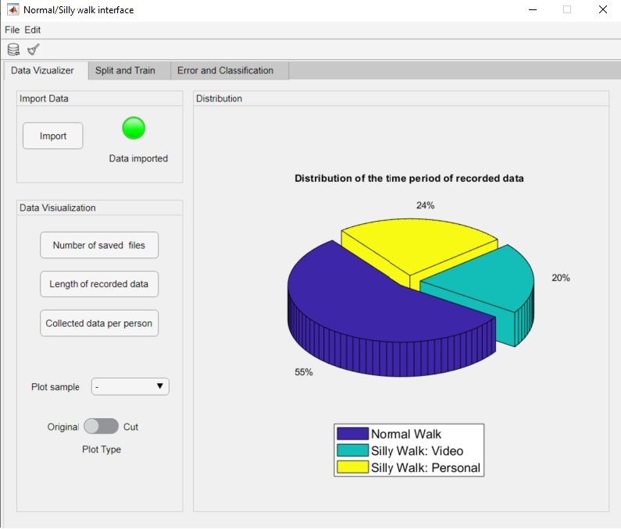
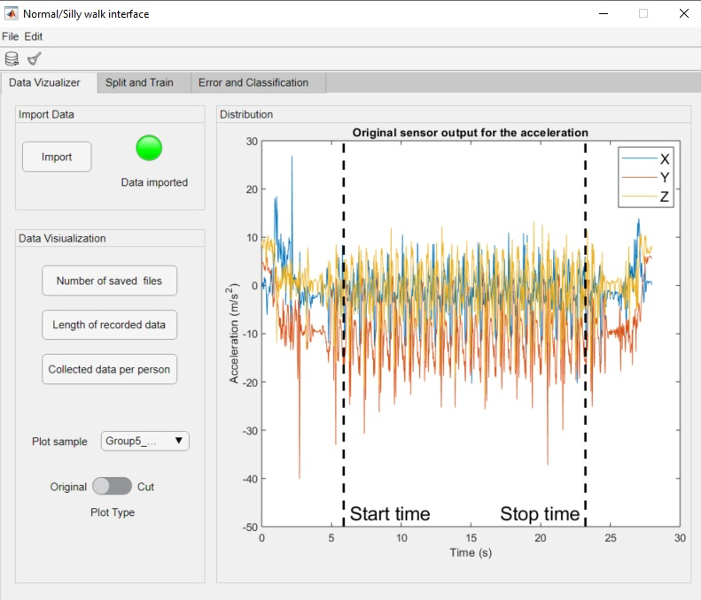
GUI
Data Visualizer
Show raw data collection
Display distribution of recorded data
Visualize data trimming

Slide 5
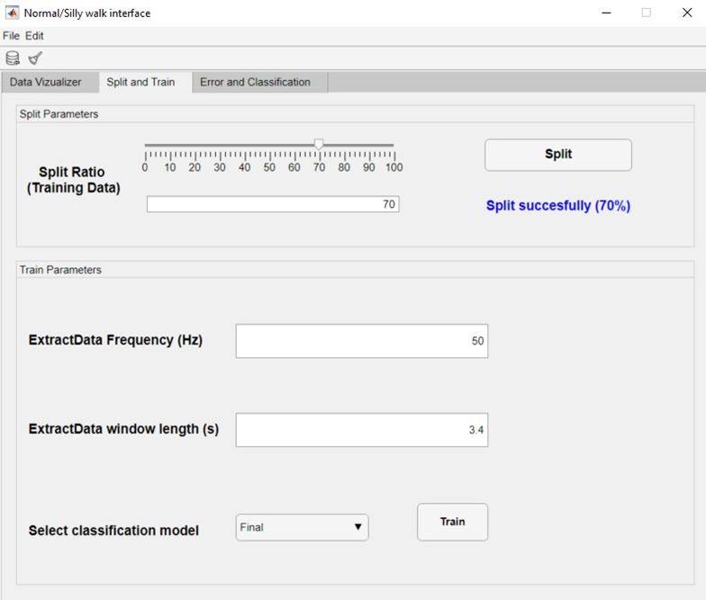
Data Split and Training
Choose sensible split ratio
Set parameters for data extraction
Train a selected model

Slide 6
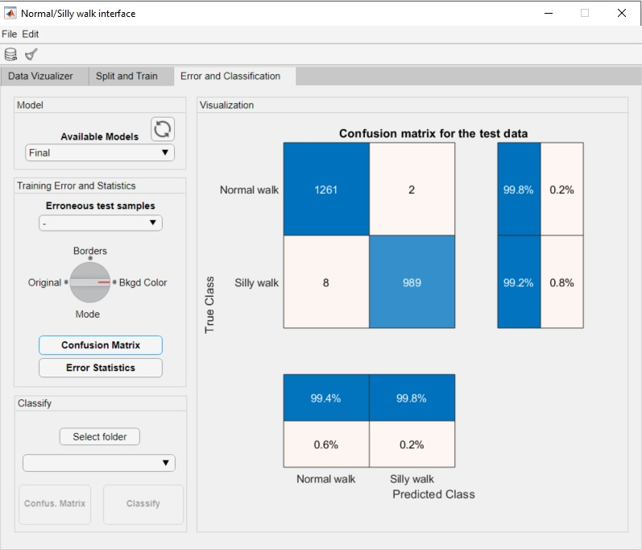
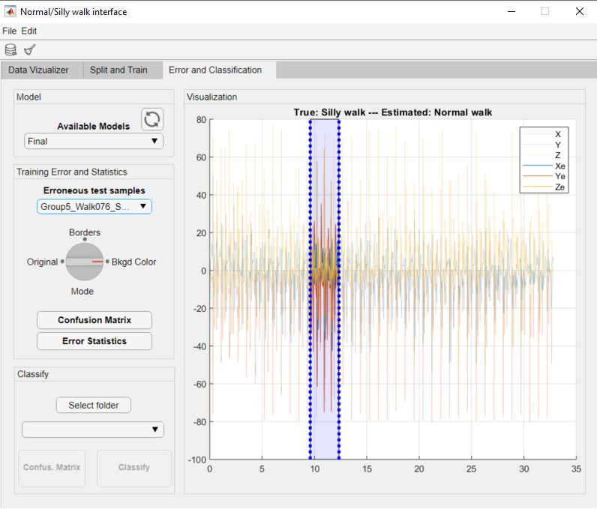
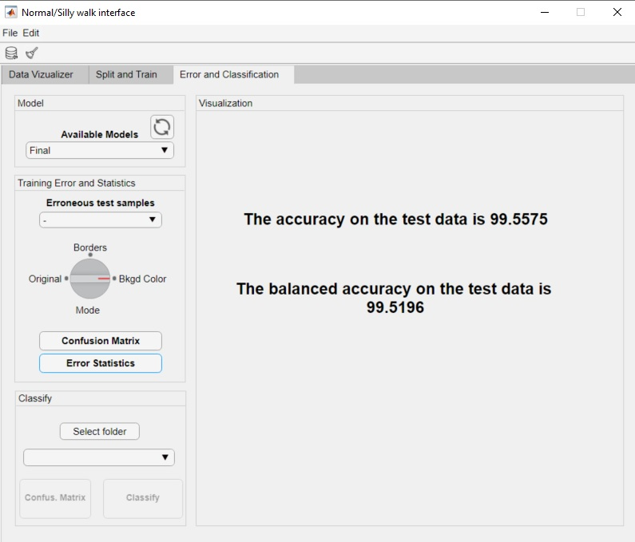
Classification
Classify test data via chosen model
Display accuracy
Analyze missclassified files
Classify any other unknown data

Slide 7





Working Style
Methods
Agile Development, SCRUM Board, Gitflow
Tools
Code: Gitlab, Sourcetree
Project + Documentation: Gitlab, Notion, Whimsical
Notes:
Explain model selection, training and classification.

